Slide 1


Python web scraping:E- commerce Data

Slide 2

Python-based Product Scraping

Slide 3

"Python is an excellent tool for extracting data from websites."

Slide 4

Data Extraction for E-Commerce Giants
INITIAL RESEARCH AND PLANNING
Our journey of data extraction began
DATA COLLECTION FROM FLIPKART
We started with researching the best approach
PYTHON CODE TO EXTRACT DATA
We successfully extracted data from flipkart

Slide 5
Data Extraction from Flipkart
EXTRACTING REQUIRED DATA FIELDS:
The data fields required are product name, price, rating, and product description. These can be extracted using the class or ID tags of the HTML code.
SCRAPING FLIPKART:
To scrape data from Flipkart, one needs to identify the target URL and traverse through the HTML tags, using the libraries mentioned above.
PYTHON LIBRARIES REQUIRED:
Some of the Python libraries required to extract data from Amazon and Flipkart are Beautiful Soup, Requests, and Selenium.
STORING DATA IN CSV FORMAT:
The extracted data can be stored in CSV format, which can then be further processed using other tools and software.

Slide 6
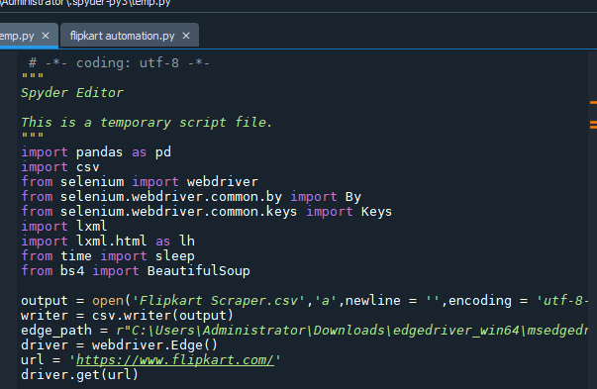
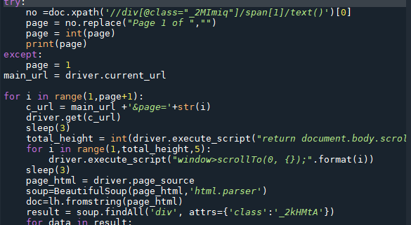
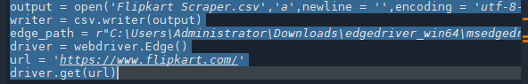

Slide 7
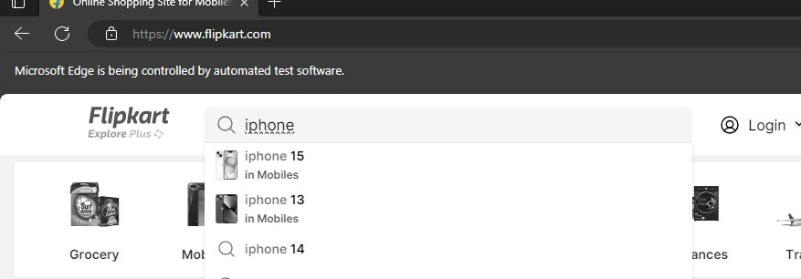
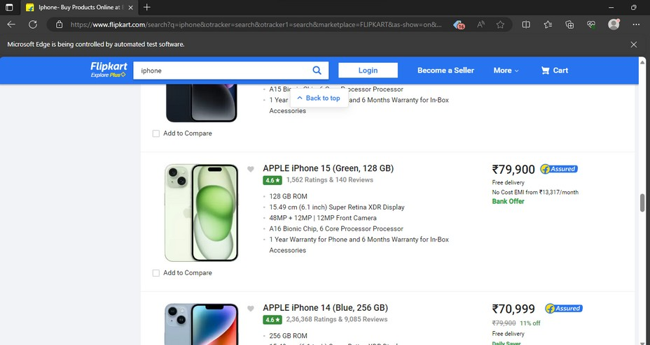

Slide 8
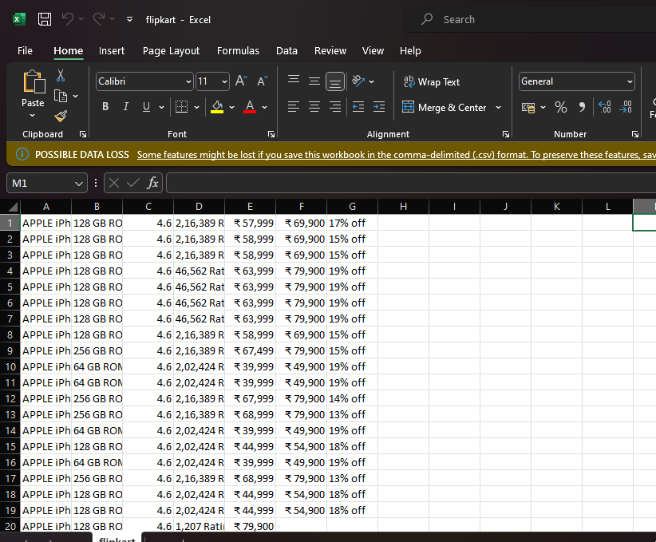

Slide 9

Happy Extracting!

